Slide 1


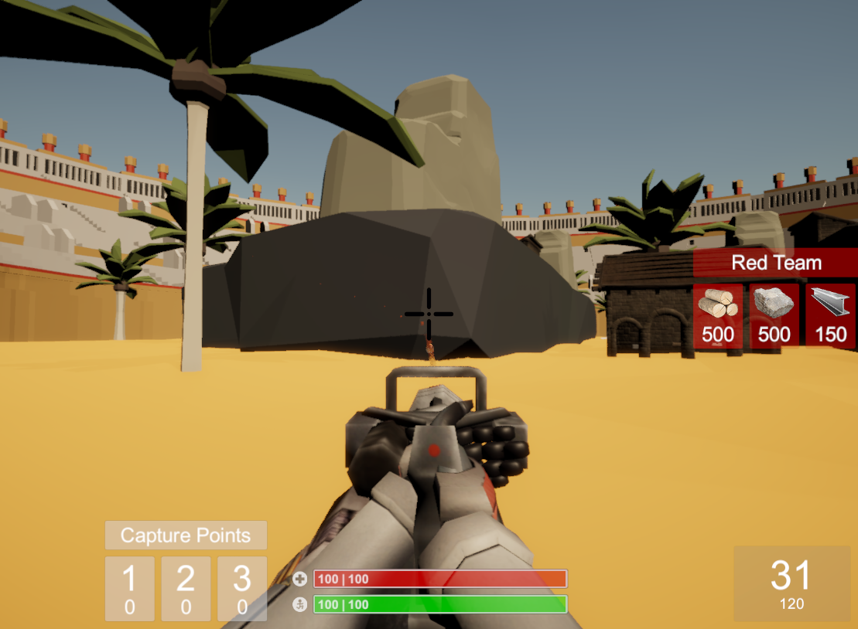
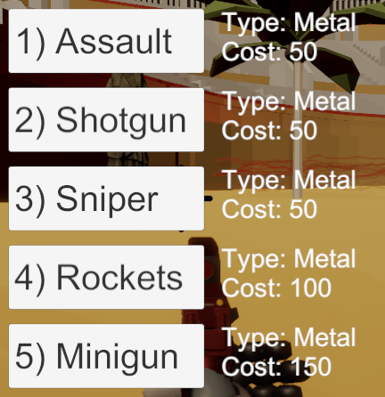
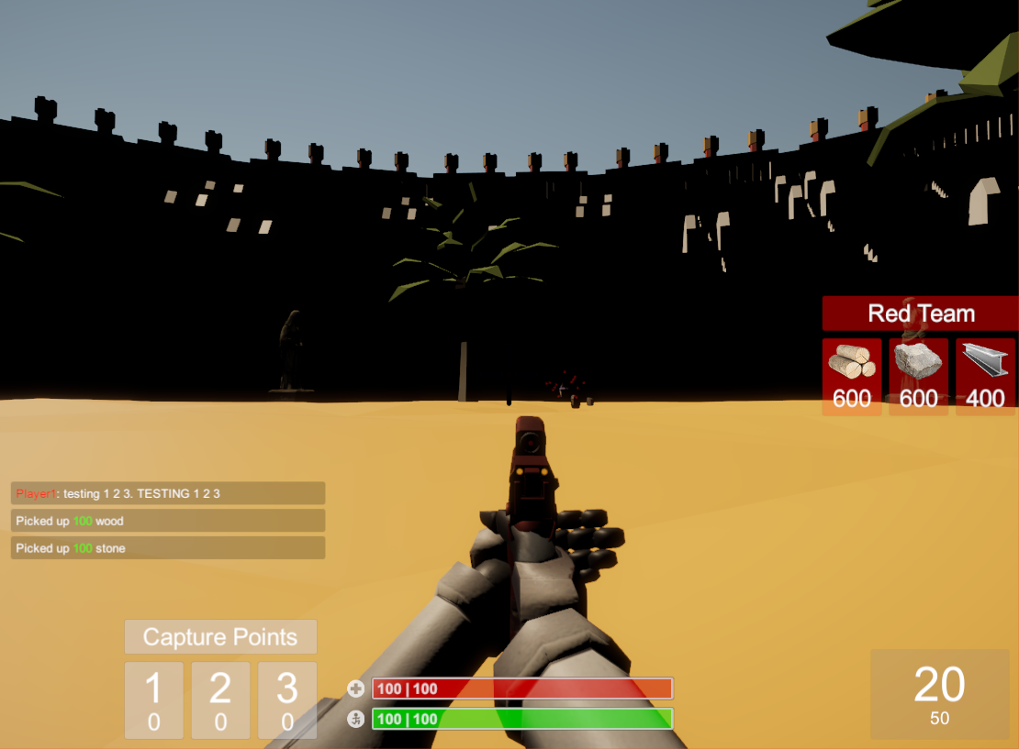
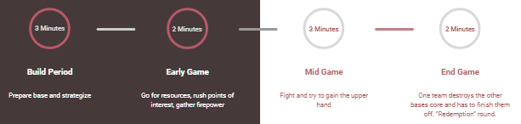


FPS Combat
Base Building
Teams
Points of Interest
Protect the Core
Multiplayer
Grab your buds. Build a base. Enjoy frantic first person combat. Battle over points of interest. Destroy the enemy’s core. All the while, try not the make the emperor angry. All this and more in BATTLEMENT BLAST!
Rapid first person combat action
Five guns with shop
Unique weapon styles
Fly with the minigun
Custom lobby
In-game chatroom
Red and blue teams
Supports up to 12 players
Fight enemies!
Play online!
Team building
Base destruction
Floors, walls, stairs, etc.
Resource collection with store
Each team spawns from their core
Objective: destroy enemy core
Please the emperor and get rewarded
Beware displeasing the emperor
Win: Leave no enemies left alive
Build a base!
Win the Game!
Post processing effects | Fully self-animated character body | Fatigue system | Console commands | Sound system
Level Design
Colosseum Idea
Concept Drawing
Implementation
3 Lanes
UI Design
Game Flow
Emperor
Ryan Stutzman
Brock Sokevitz
Jake Ruth
Lucas Puskaric
Rickie Kidwell
Alex Barnes
A game by

